Slide 2


Slide 3


Slide 4
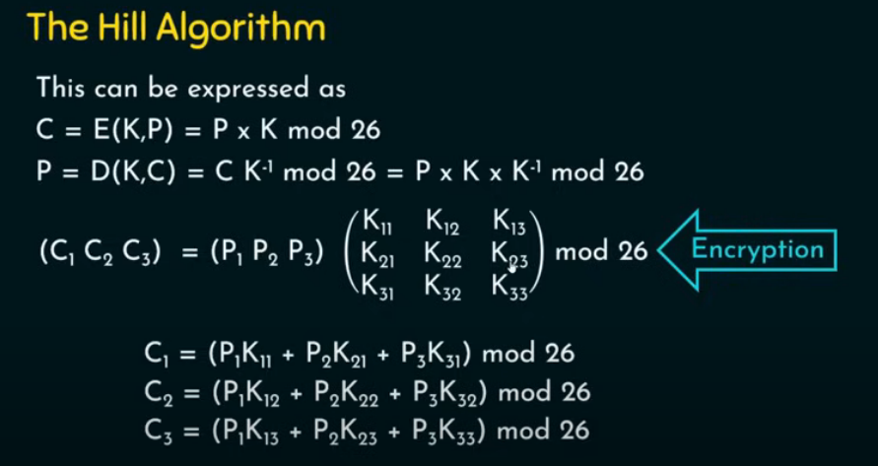

Slide 5


Slide 6

Step1:

Slide 7

Step 2

Slide 8
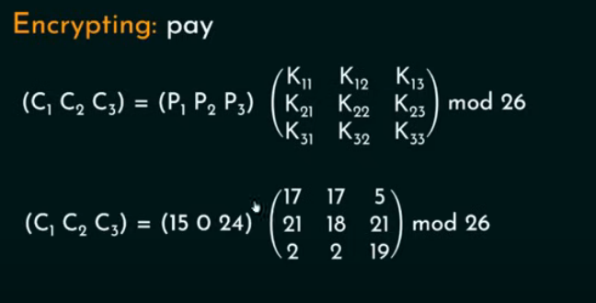

Slide 9

RRL

Slide 10
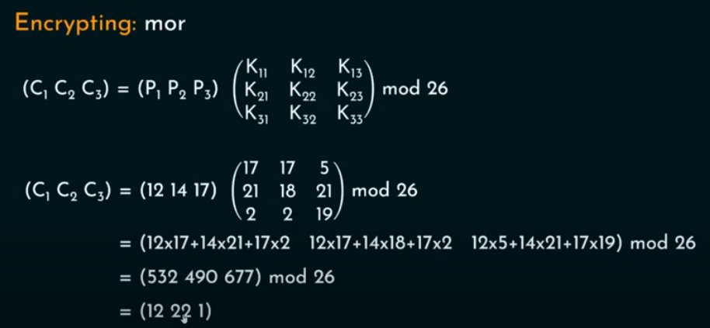
MWB

Slide 11
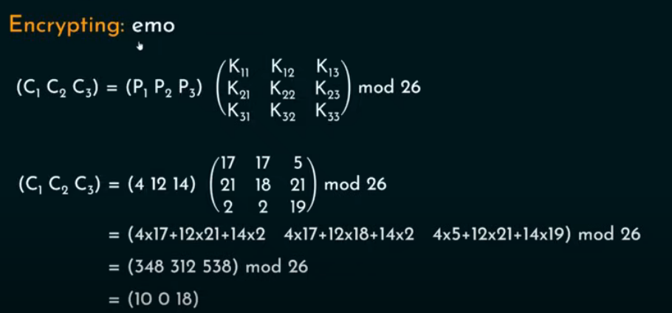
kas

Slide 12
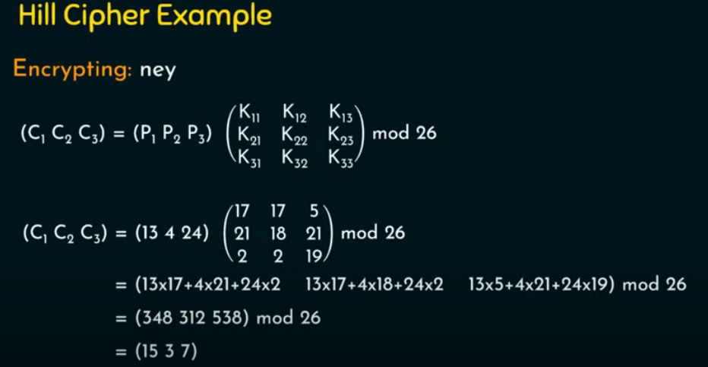
pdh

Slide 13


Slide 14


Slide 15
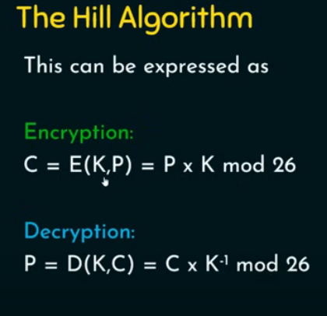

Slide 16


Slide 17


Slide 18
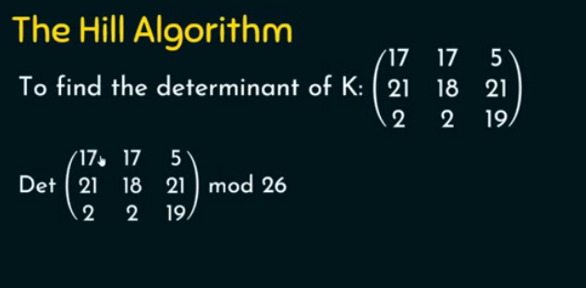

Slide 19
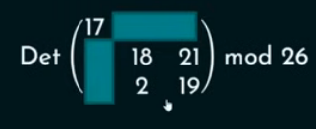
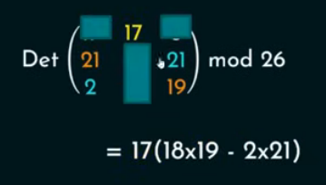



Slide 20

23

Slide 21
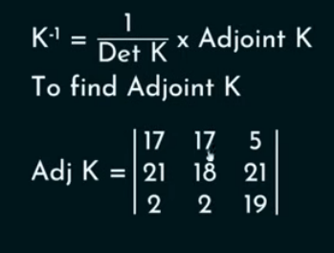
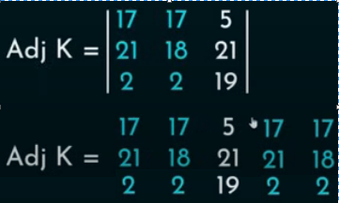
To find Adjoint k
Step 1
Step2:repeat first column again

Slide 22
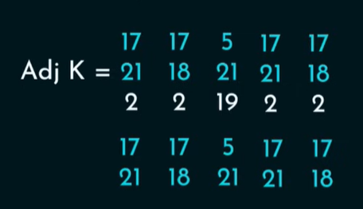

To find Adjoint k
Step 3:repeat first two row again
Step4:hide first row and column

Slide 23

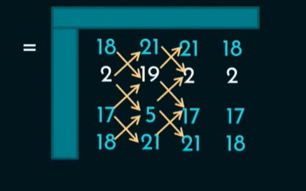
To find Adjoint k
Step 5:
Step6:

Slide 24
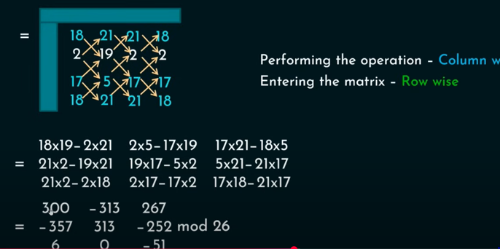

Slide 25
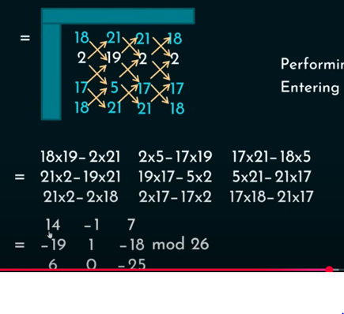

Slide 26
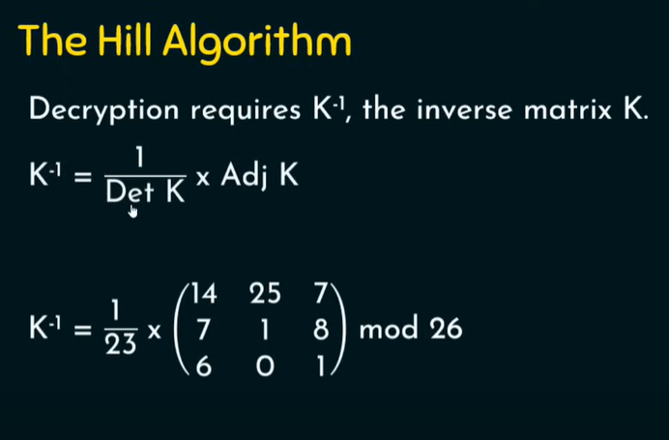

Slide 27



Slide 28
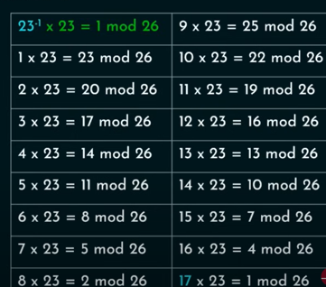
23 inverse is 17 how?
When multiplicative inverse multiplied with that number and should get one as result remainder ,when you do mod 26 of the number
target
Possible tries
Target satisfied

Slide 29

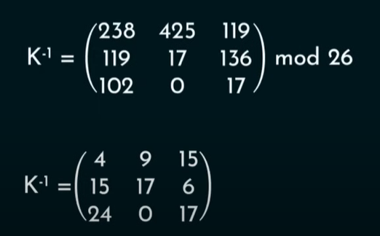
Continue with problem

Slide 30
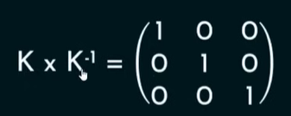
To verify

Slide 31
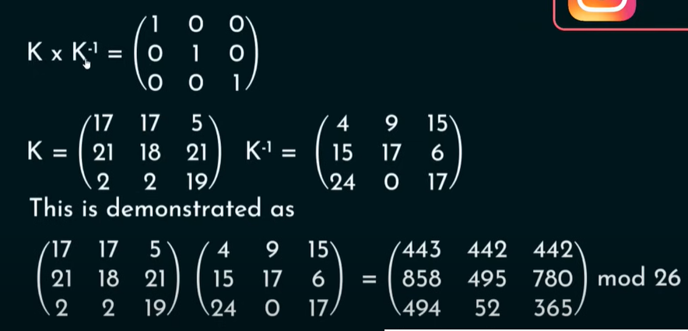
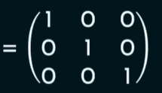

Slide 32



Slide 33
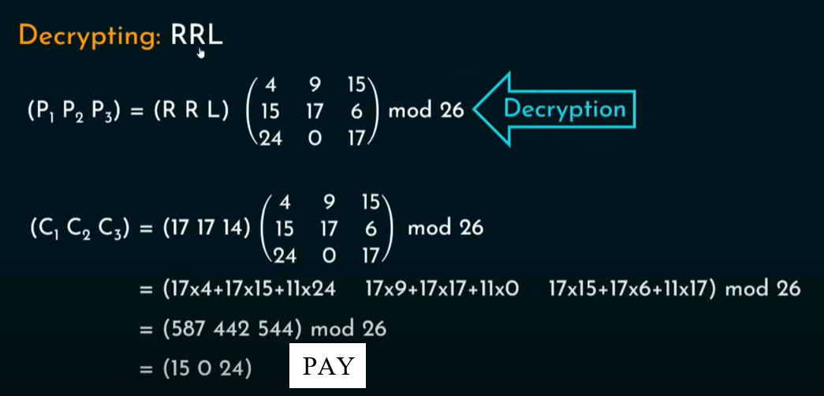

Slide 34
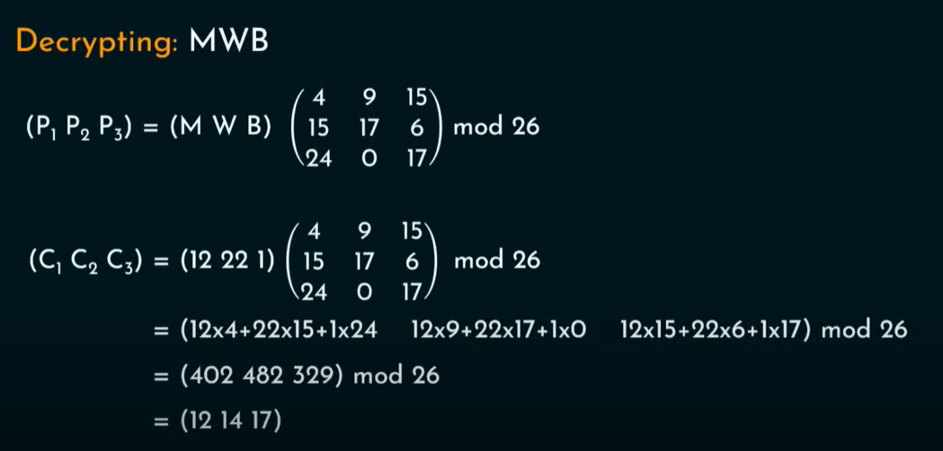


Slide 35
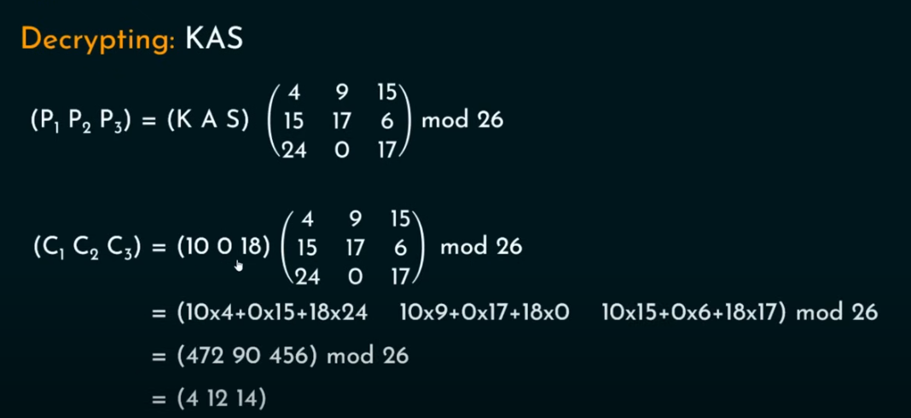


Slide 36
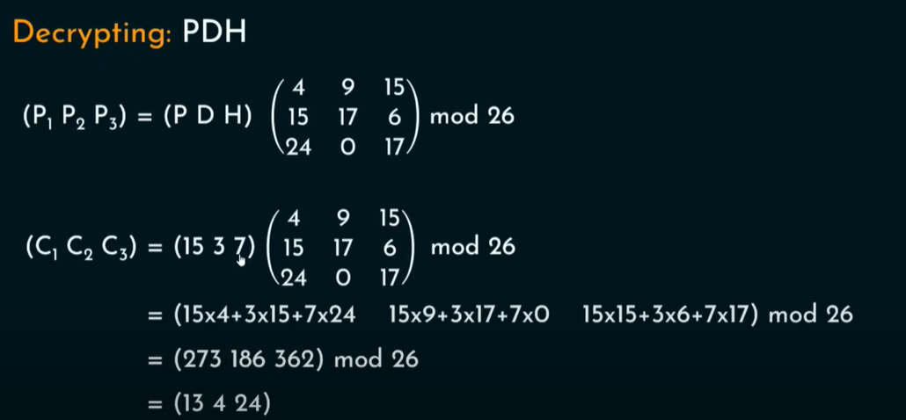


Slide 37

FINAL ANSWER

Slide 38


